Slide 2
Do Changes in Development Assistance for Health Crowd out Domestic Investment and What are the Implications for HIV/AIDS outcomes?
Bryan N. Patenaude, ScD
Share your thoughts on this presentation with #IAS2019

Slide 3
Key Questions
How has development assistance impacted domestic investment in health between 2000 & 2015?
How have the dynamics between development assistance and domestic expenditure impacted HIV/AIDS outcomes?

Slide 4
Background: Global Health Expenditure
Data Source: Institute for Health Metrics and Evaluation (IHME). Financing Global Health Visualization. Seattle, WA: IHME, University of Washington, 2017. Available from: http://vizhub.healthdata.org/fgh/

Slide 5
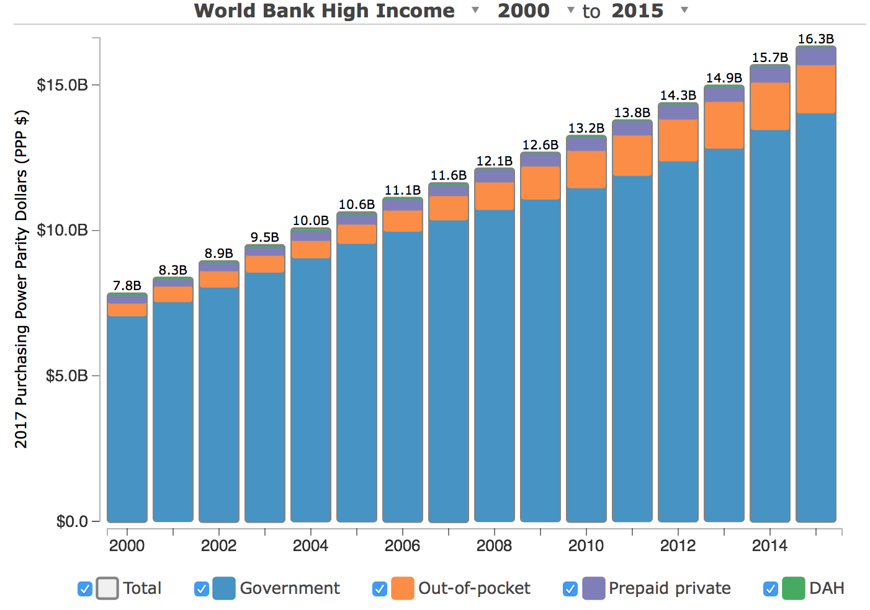
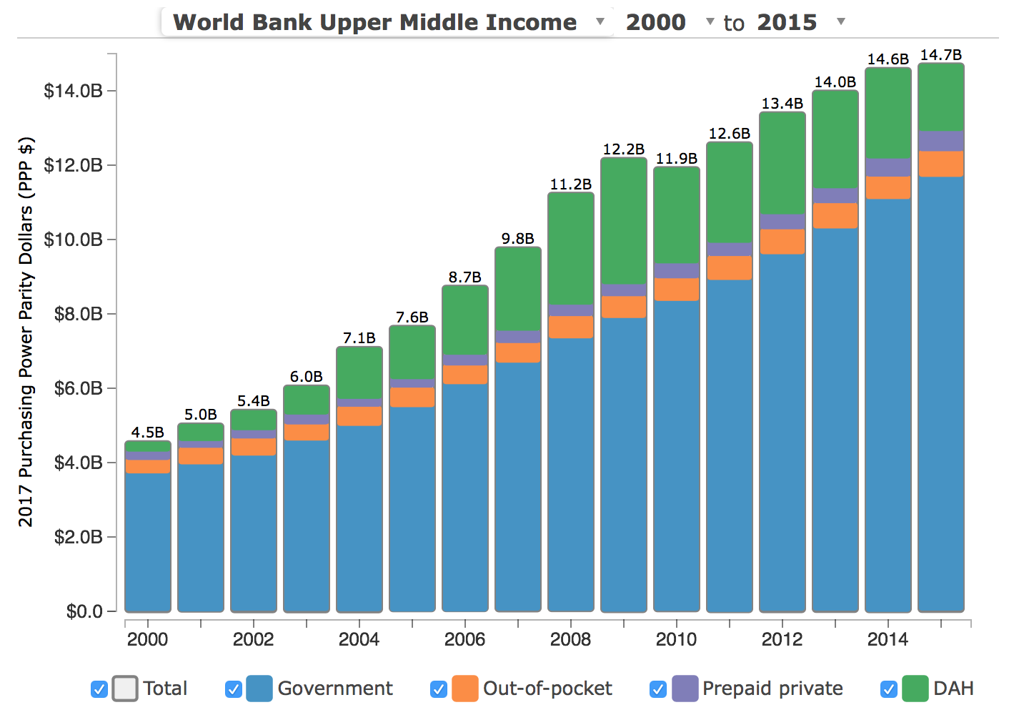
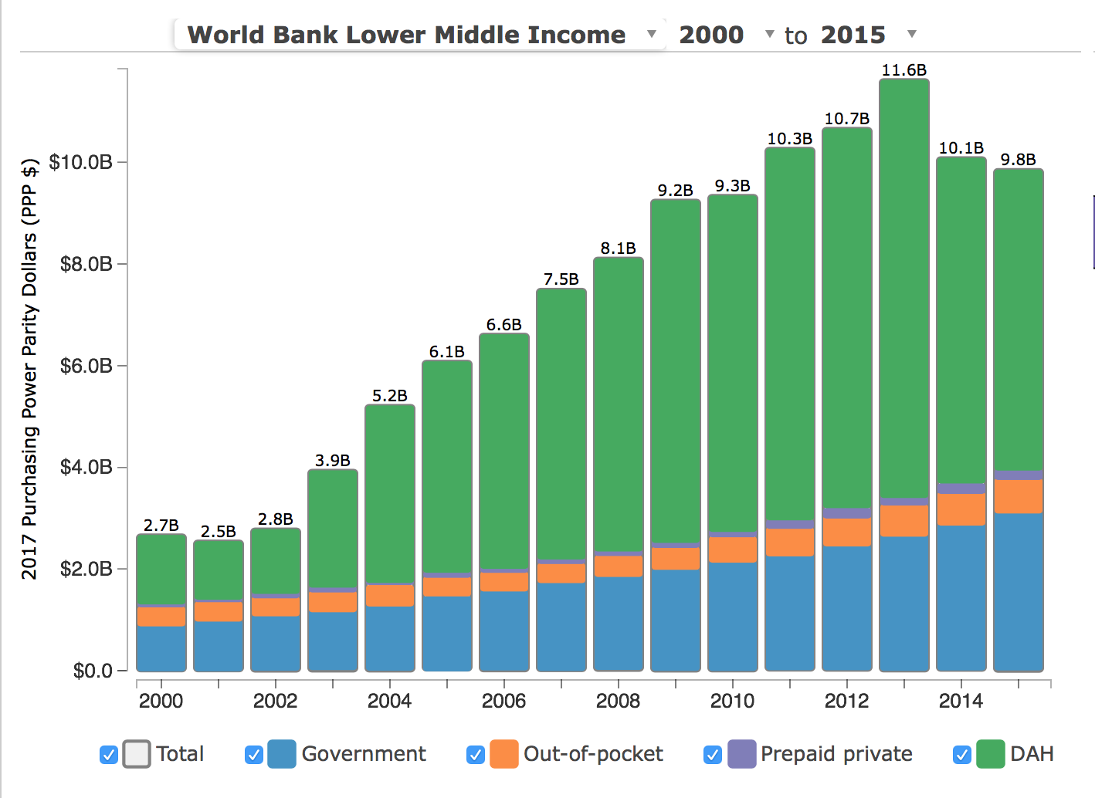
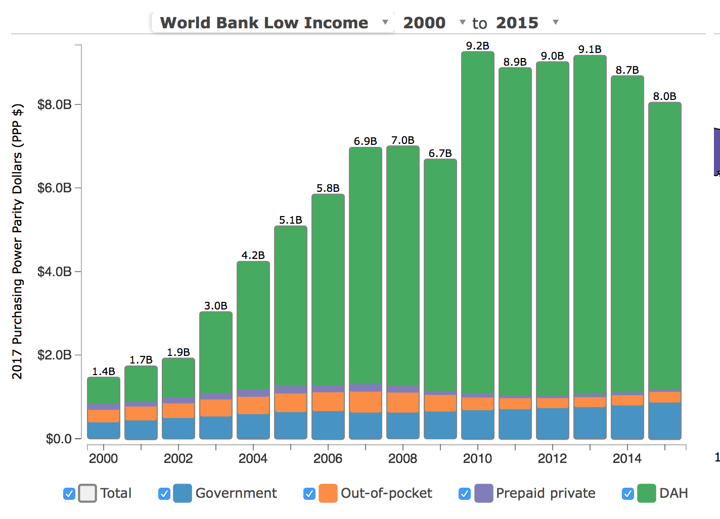
Background: Global HIV/AIDS Expenditure
Data Source: Institute for Health Metrics and Evaluation (IHME). Financing Global Health Visualization. Seattle, WA: IHME, University of Washington, 2017. Available from: http://vizhub.healthdata.org/fgh/

Slide 6
Data
Sources:
Institute for Health Metrics and Evaluation’s (IHME) Development Assistance for Health dataset
IHME’s Health Expenditure dataset
World Bank Databank
World Health Organization’s Global Health Observatory
Description:
237,656 individual development assistance transactions
Over 15 years (2000-2015)
30 source countries
Channeled through 42 bilateral, multilateral and private organizations
174 distinct recipients.

Slide 7
Trends in Expenditure (2010 – 2015)

Slide 8
Trends in Development Assistance & HIV Prevalence

Slide 9
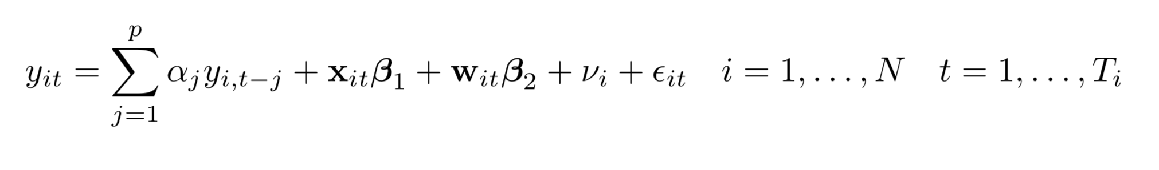
Methods – The Model
The model is a dynamic panel Arellano-Bond style system generalized methods of moments (GMM) model, designed for panels with many individuals and few time periods.
Allows for
  Independent variables that are not strictly exogenous (w)
  Dynamic dependent variables correlated with lags (y)
  Exogenous variables (x)
  Lagged levels and differences as instruments
  Fixed effects (time)
  Heteroskedasticity & autocorrelation within individuals

Slide 10
Modeling Procedure
Assess the impact of changes in the level of development assistance for health on both domestic public & private health spending
Control for demographic covariates and utilizes the full 15-year time history of the dependent variable as instruments, along with co-moving trends (e.g. population size).
Employs a systems approach to determine the impact of these dynamics in development assistance and domestic financing on mortality, HIV prevalence, and TB prevalence

Slide 11
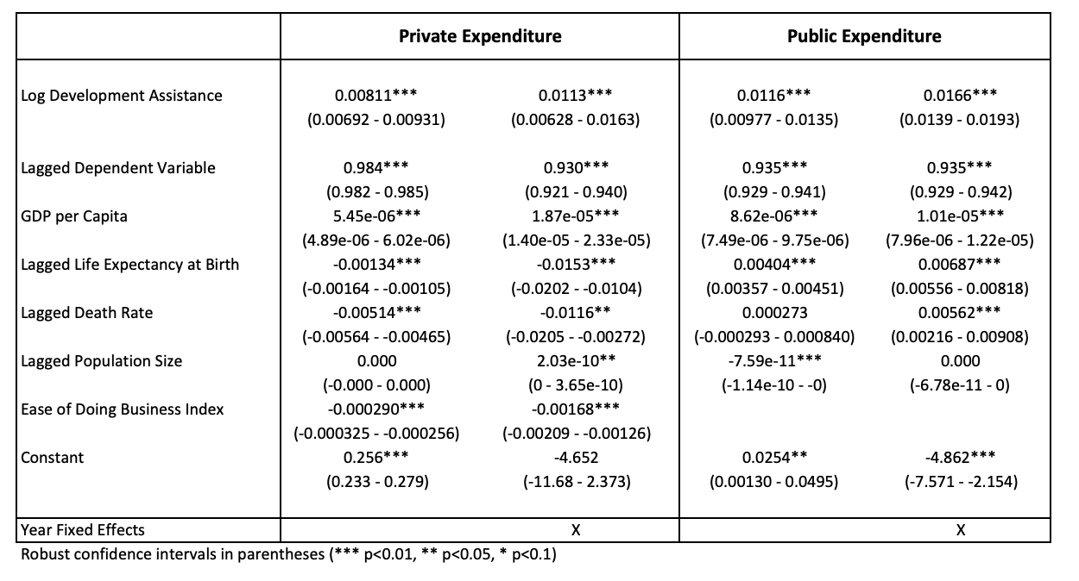
Results: Public & Private Expenditure

Slide 12
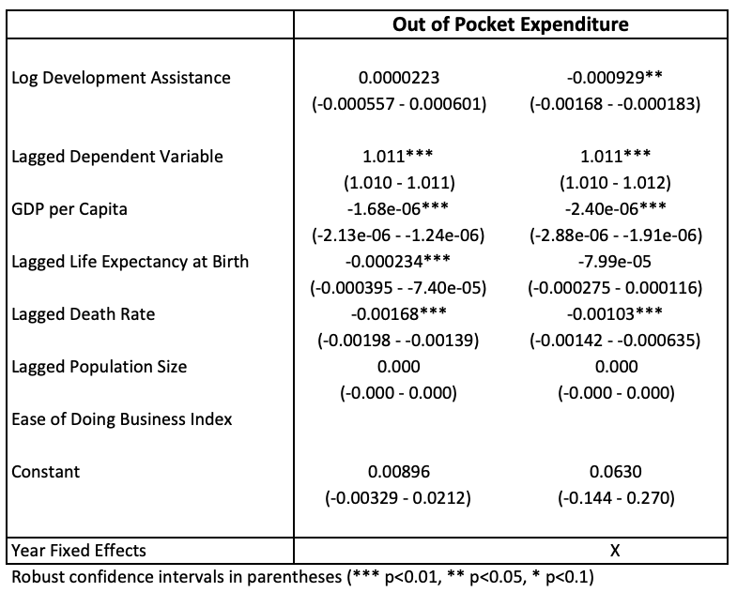
Results: Out-of-Pocket Expenditure

Slide 13
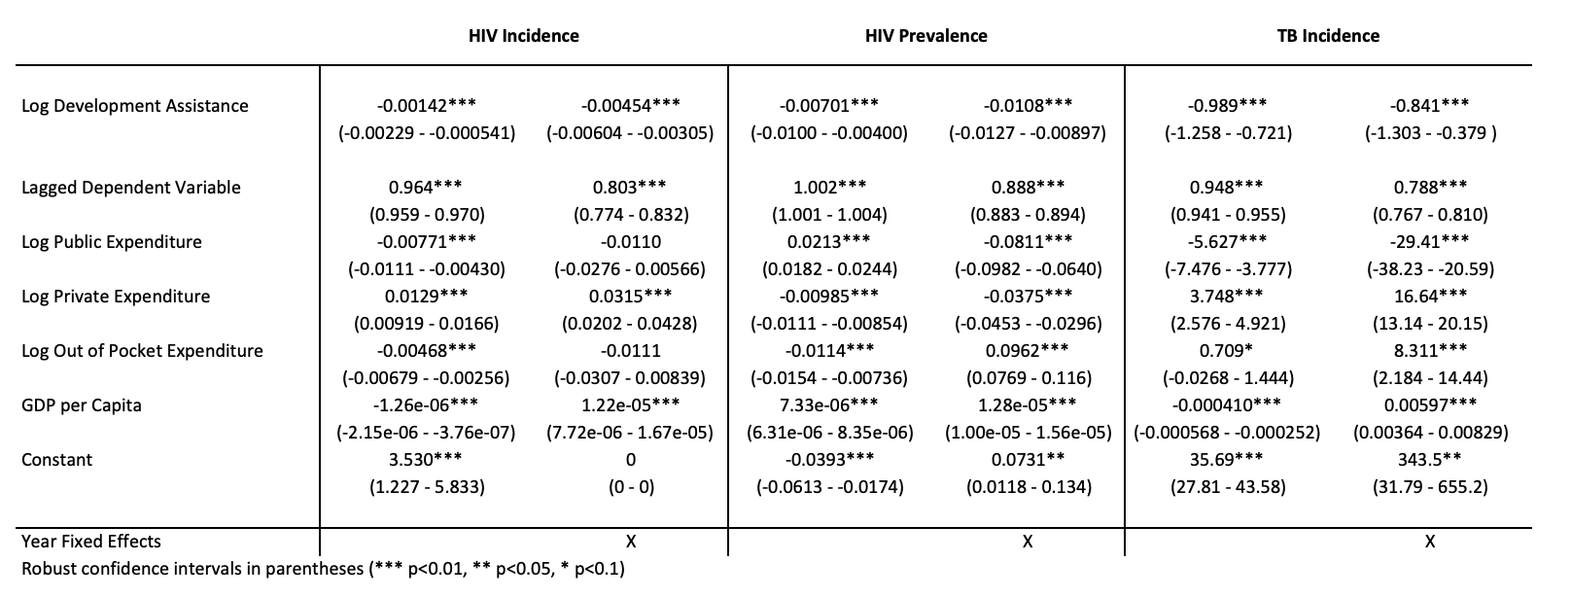
Results: Health Impact – HIV & TB

Slide 14
Results Summary
Between 2000-2015, a 1% increase in Development Assistance for Health has resulted in:
  0.011% increase in private health expenditure
  0.017% increase in public health expenditure
  0.001% decrease in out-of-pocket expenditure
  0.841% decrease in tuberculosis incidence
  0.005% decrease HIV incidence
  0.011% decrease HIV prevalence

Slide 15
Discussion
Increases in development assistance between 2000 and 2015 have had a modest but beneficial impact on domestic health expenditure & HIV/AIDS outcomes.
Provides some evidence to demonstrate that attempts to strengthen domestic health financing has been successful.
More effort could be placed on mitigating out-of-pocket expenditure and financial vulnerability.

Slide 16
Limitations
Data quality concerns?
  Many of the data points are modeled (e.g. HIV incidence)
Sensitivity of the results to the choice of GMM-style lag specification.
  Many different possible specifications, more work needed to examine sensitivity of results to structure
Type of development assistance probably matters
  More specific types of investment might be more useful to look at (e.g. HIV-specific investments on HIV outcomes)

Slide 17
Conclusions
Between 2000 and 2015 development assistance for health has:
  Crowded-in domestic public health investment
  Crowded-in domestic private investment
  Mildly crowded-out out-of-pocket expenditure
These dynamics in development assistance over time have:
  Reduced incidence & prevalence HIV
  Reduced incidence of TB

Slide 18
Thank You!

